Slide 1
World Nature Organization
Environmental Organization

Slide 2
When was it founded?
The WNO was first formed in 2010, but wasn’t fully in affect until May 1st 2014.

Slide 3
Goals
Their goal is to protect the environment globally. Their main focus is on energy efficiency, climate protection, sustainable development and environmental protection, sustainable development, and a sustainable energy supply.

Slide 4
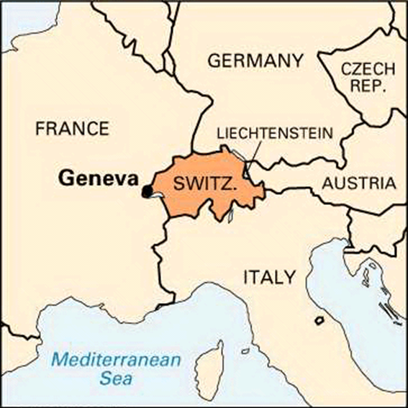
The first WNO office has opened in Geneva Switzerland on the 1st of this month

Slide 6
How does WNO work?
They attempt to build bridges between business interests as well as development and environmental protection; as well as making people aware of the economic value of nature.

Slide 7
How is the organization set- up?
Certain groups that are affected by a particular environmental issue join together to approach it in a bilateral manner.

Slide 8
History
In 2010, some emerging developing countries threatened by environmental issues mandate the WNO; the world’s first intergovernmental organization dedicated to worldwide environmental protection. WNO-Treaty officially entered into force on May 1st, 2014.

Slide 9
What is it’s role in internationalism?
The WNO allows for nations to join together and confront their common environmental problems as a combined force. (bilaterally)

Slide 10
What does it promote?
Global and environmental protection.

Slide 11
Who are the major players in the organization?
The WNO is an intergovernmental organization and doesn’t really have a certain few above everyone else.

Slide 12
Why do nations become involved with this organization?
Nations join the WNO to solve their environmental issues along side other nations that share the same problems.

Slide 13
What are reasons that nations would refrain from joining the WNO?
Some nations will refrain from joining the WNO to isolate themselves from any possible ties to other countries that come along with the joining of the WNO. Also the nation would be discouraged from extracting natural resources, which is a large loss to places that rely on it for income and exchange.

