Slide 1
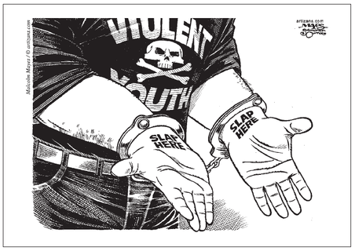
The Youth Criminal Justice Act

Slide 2
What is the YCJA?
Applies to all young people who are 12-17 years old
Law says your are an adult at 18, so at 18 the YCJA does not apply
Young people must be accountable for their actions which means that they must face the consequences for their wrong-doings
Consequences must be proportionate to the seriousness of the crime
Prohibits adult sentences for adolescents 12-14
Allows adult sentences for those 14 and over if crime is serious enough
Allows most young offenders to avoid a criminal record

Slide 3
Principles and Objectives of the YCJA
Prevent crime by addressing the circumstances underlying a young person’s behaviour
Rehabilitate and reintegrate young people who commit offences into society
Ensure that a young person is subject to meaningful consequences for his or her offence
Recognize the immaturity/maturity of the offender
Promote long term protection of the public

Slide 5
What are “meaningful consequences”?
Steps taken to help youth understand the implications of their actions and to fix the harm done to others
Address the crime
Mean something to the offender
Reinforce respect for Canadian values
Help fix the harm done to victims and the community
Respect gender, ethnic, cultural, and language differences
Involve the family, the community, and other groups
Respond to the needs and lives of Aboriginal youth and youth with special requirements

Slide 6
Consequences
Custody as a Consequence
Statistically, not the best approach as offenders often learn ‘prison’ habits
Extrajudicial Measures
Design to keep offenders out of the court system by taking responsibility
Apologize, counselling, restitution
More meaningful and focus on repairing the relationships broken
Restorative Justice
Victims, victims’ families, offender, and the community reconcile
Rehabilitation
Drug and alcohol counselling, anger management, job training
Reintegration
Attend school, obey curfew, not associate with certain people, not use drugs/alcohol
Criminal Record
Even a ‘closed youth record’ can be reopened in adulthood if more crimes are committed

Slide 7
Two Scenarios – you be the Judge
Joy Riding
Jackie is 12 years old. One day, she and her friend Barb, who is also 12, were walking home from school when they saw a car parked at the side of the road. They noticed the keys were in the ignition. They decided to take the car for a joy ride down by the beach because they knew other kids their age would be there and they wanted to impress them. On the way to the beach, however, a police car stopped them because they were speeding. Their joy ride was over.
Do you think these young people broke the law? How?
Do you think they are responsible for their actions, or that their parents should be? Why or why not?
How would the owners feel when they found out the car was stolen?
What should happen to the youth? What would you do? Punish them? Help them? How? Have them repair the harm they did? How?
Do you think their parents should deal with the incident rather than the courts?
GTA
Peter, 17, is in Grade 12. He has an 11-year-old brother, Jimmy. One of Peter’s friends at school, Jack, is 18. One evening, Peter went over to Jack’s house. He took Jimmy with him. Jack suggested they go out. Walking down the street, they saw a car with a lot of things in it. No one was around. Peter and Jack decided to break into the car. Jimmy helped them. Someone saw them and called the police. All three boys were caught. Each of the boys was treated differently. A police officer took Jimmy home to his parents and explained what had happened. Jack and Peter were taken to the police station. The police told Jack that he would have to go to adult court. They told Peter that he might have to go to youth court. The police said that Peter would have a chance to talk to a youth probation officer first, to find out why he got into trouble. Jack said, "That’s not fair. All three of us did the same thing. We should be treated the same."

