Slide 1
The Civic Nation
What is a ‘Civic Nation’?

Slide 2
Define and add these terms to your list
Civic Nation
Constitution
Entity

Slide 3
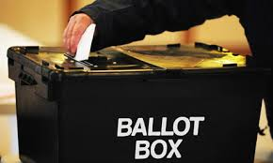
Civic Nation

Slide 4
Civic Nation

Slide 5
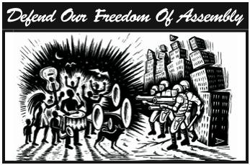
Civic Nation

Slide 6
Civic Nation

Slide 7
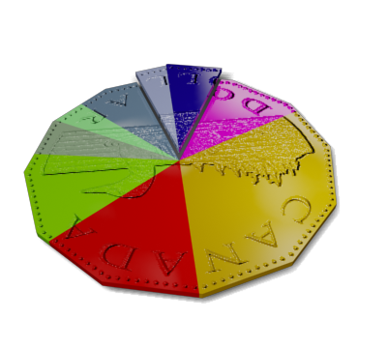
Civic Nation

Slide 8
Civic Nation

Slide 9
Charles Hanley
“In the psychological sense, there is no Canadian nation as there is an American or French nation. There is a legal and geographical entity, but the nations does not exist. For there are not objects that all Canadians share as objects of national feeling”

Slide 10
Aspects of the Civil Nation
Shared Values and Beliefs
Expressing Shared Values and Beliefs
Nation and Nation-State
Civic Nationalism and Ethnic Nationalism
Using the textbook pages 31-33, complete the handout

Slide 11
Mustafa Kemal Ataturk
Founder of the Turkish Nation
Read ‘Making a Difference’ on Page 34
Complete questions 1, 2, and 3

