Slide 1
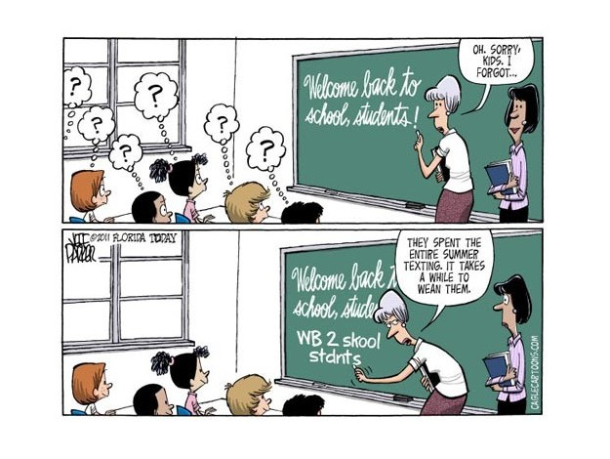
Promoting Language & Culture
How do people affirm and promote their language and culture in a globalizing world?

Slide 2
Affirming language
People express their traditions, values, world views, and cultures through language
“Even when they are unwritten, languages are the most powerful tools we have to conserve our knowledge, transmitting it...to the next generation. Any human language binds together a human community, by giving it a network of communication”

Slide 3
Language groups in canada

Slide 4
Differing views
Some believe that globalization will bring greater understanding and interdependence among the people of the world
Some believe that globalization threatens cultural diversity, and the proof is through so many endangered languages

Slide 5
Endangered languages
On average, 1 language disappears every 2 weeks
An estimated 6000-7000 languages are spoken on Earth
96% are spoken by 4% of the world
More than half are endangered
How many languages can you name?

Slide 6
Dominance of English
The major language of business, scientific research, and popular culture
Main language of Internet and World Wide Web
90% of content on Internet is only in 21 languages

Slide 7
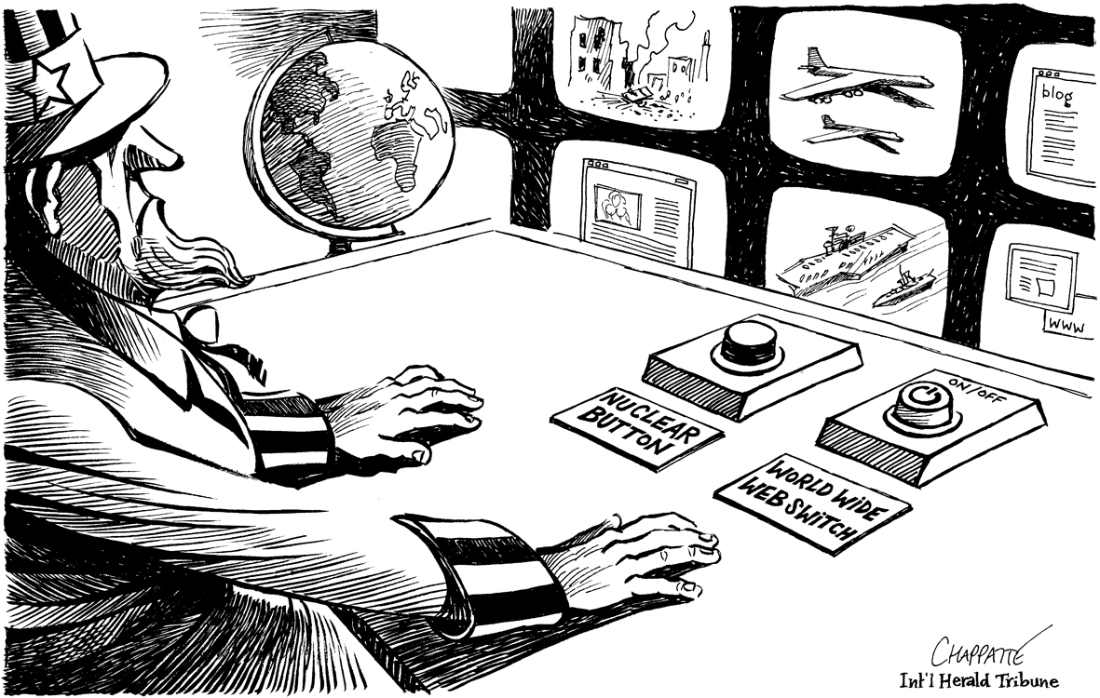
Source analysis

Slide 8
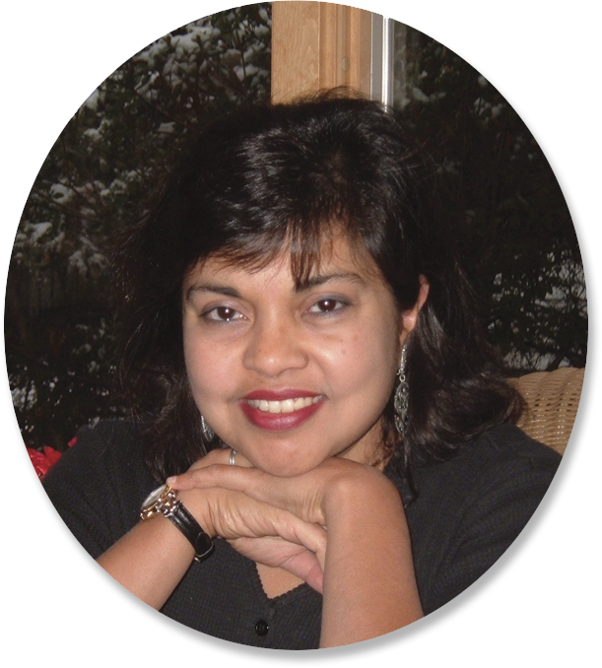
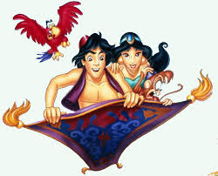
The ‘Magic carpet’

Slide 9
Reaffirming Culture
Collectives affirm their identity when they speak their language or express their culture, nation, or gender
Some cultures reclaim what has been lost
Example – 2006 – the Haisla reclaimed a totem pole from the National Museum of Ethnography in Stockholm, Sweden that was taken in 1927

Slide 10
Tartar people
Live in the Crimean region of Ukraine and their language is ‘seriously endangered’
Weakened by Russian rule, and Soviet dictatorships
The Krymsky Education Society of Edmonton is helping revitalize the Tartar culture by producing bilingual Ukrainian and Tartar textbooks for the children of Crimea

Slide 11
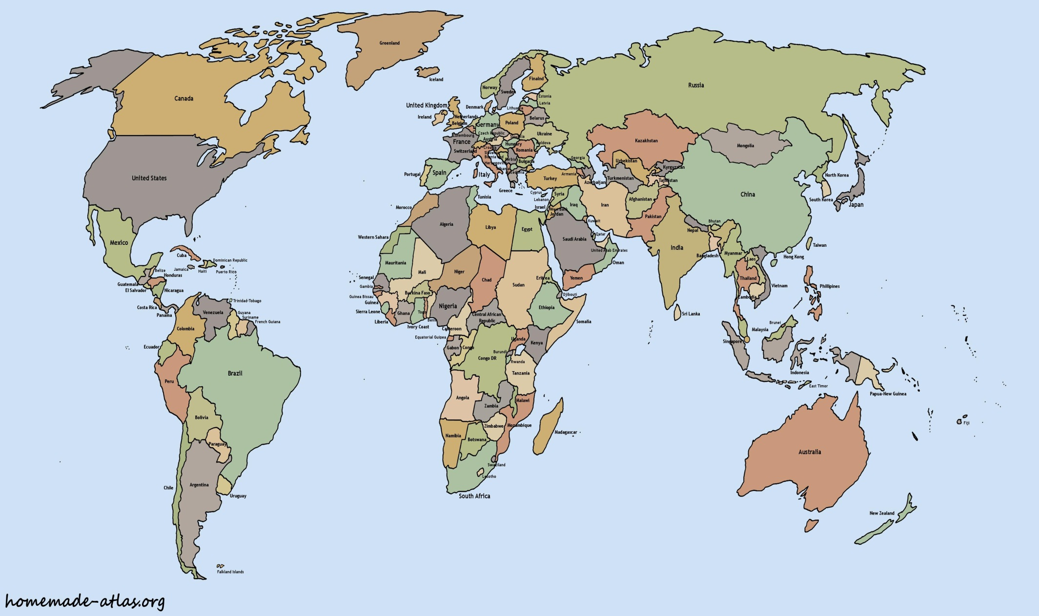
Edmonton & Crimea

Slide 12
Cultural Revitalization
Is one way for a nation to keep their cultural identity from being absorbed by globalization
Many artefacts in museums were taken illegally from cultures, specifically Aboriginal Peoples
Museums are now returning these treasures to their rightful owners

Slide 13
Three views
Pg. 97
Viewpoints of Deven, Gord, and Katerina
Use these viewpoints to complete the handout

Slide 14
Ladakh – Responding to globalization
Pg. 98-99
Read the case study
Complete the questions at the end
Be prepared to share your views with the class

