Slide 1
Nationalism
Social Studies 20-2
To what extent should we embrace nationalism?

Slide 2
Examples of Nationalism

Slide 3
Nationalism

Slide 4
Nationalism

Slide 5
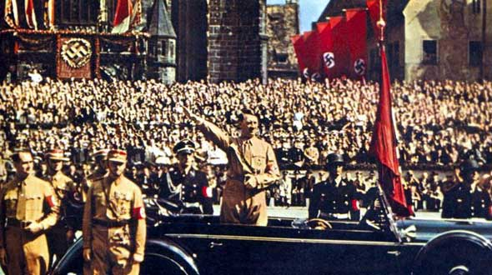
Nationalism

Slide 7
Nationalism

Slide 8
Nationalism

Slide 9
Nationalism

Slide 10
How do you define Nationalism?

Slide 11
Final Thoughts?
http://www.youtube.com/watch?v=BRI-A3vakVg

