Slide 1
Nation & Identity
Overview

Slide 2
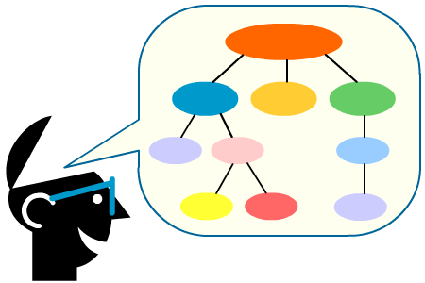
What are some concepts of nation?
Nation as Us
Country and Nation
Nation as a Concept
Nation as a Collective Concept
Nation as a Patriotic Concept

Slide 3
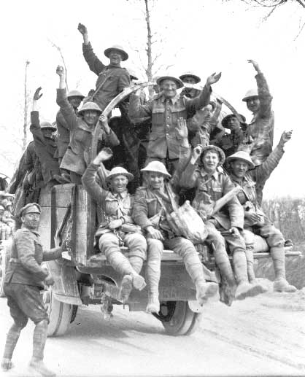
Nation as Us
“Every nation has a creation story to tell” – PM Stephen Harper
Vimy Ridge – an achievement that symbolilzed the country’s coming of age as a nation

Slide 4
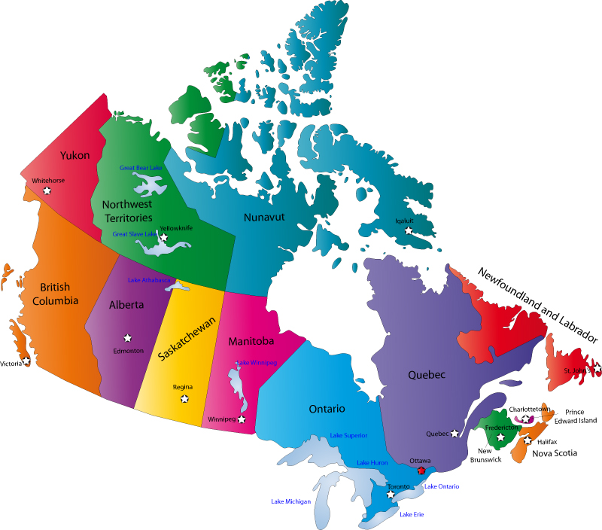
Country and Nation
“Nation-state” means country
“Internationalism” means “between countries or nation-states”
“Nationalism” means “striving for a country”

Slide 5
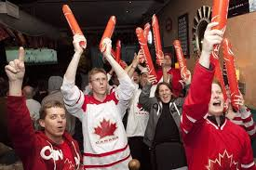
Nation as a Collective Concept
Using terms like “we”, “us”, and “our”
Shows people are thinking collectively

Slide 6
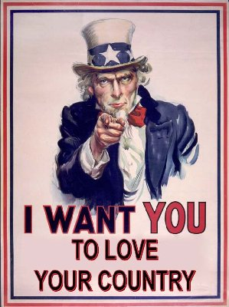
Nation as a Patriotic Concept
Patriotism – Love of one’s country
What is ‘Patriotism’ to you?
Would you ‘die’ for your country?

Slide 7
What are some understandings of nation?
Linguistic
Ethnic
Cultural
Religious
Geographic
Relationship to Land
Spiritual
Political

Slide 8
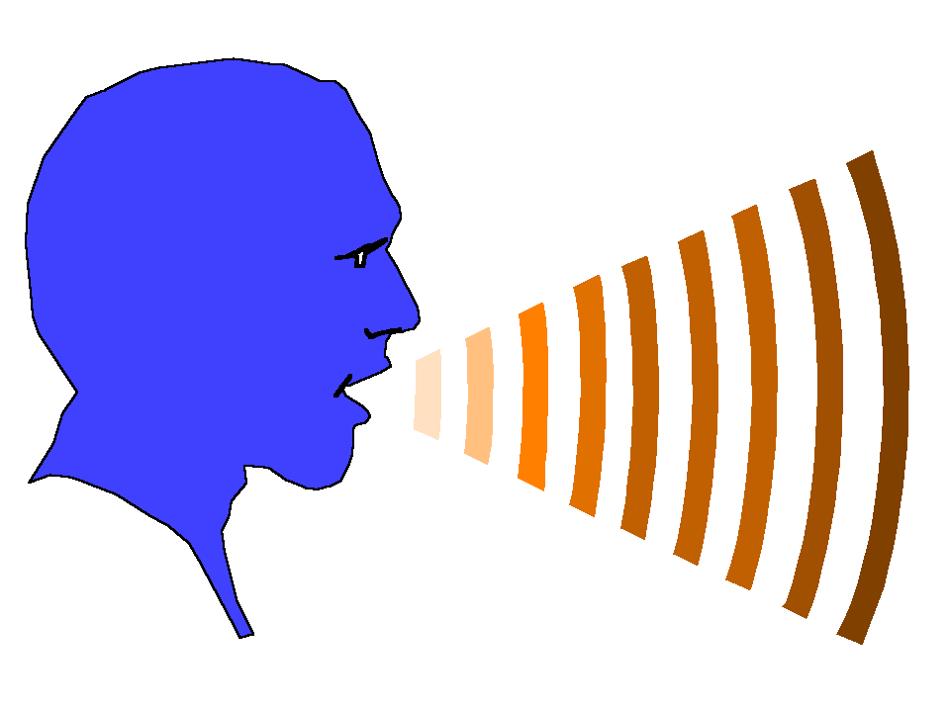
Linguistic Understandings
A common language can inspire a sense of nation
It creates a mental universe that is shared by the people that who speak the same language
Linguistic understanding of nation is strong between Quebec and Francophones across Canada

Slide 9
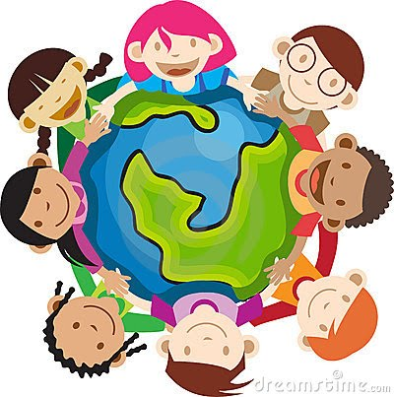
Ethnic Understanding
Many nations come into being because people share the same ethnic – racial, cultural, or linguistic – characteristics
Protects collective identity, but can create a fear of the ‘other’
Ukrainian Albertans

Slide 10
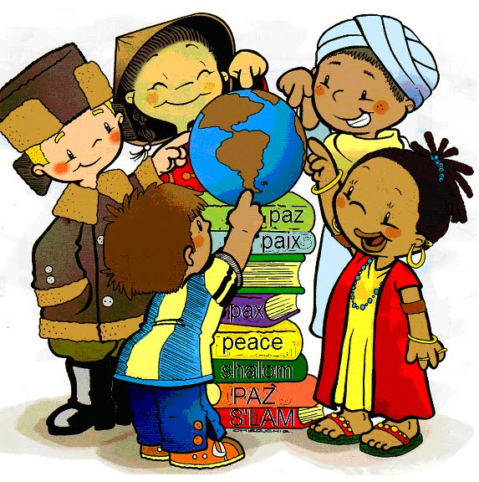
Cultural Understanding
Culture is the ways of life that people share
Cultural aspects of nation are often closely related to ethnicity
First Nations & Haida

Slide 11
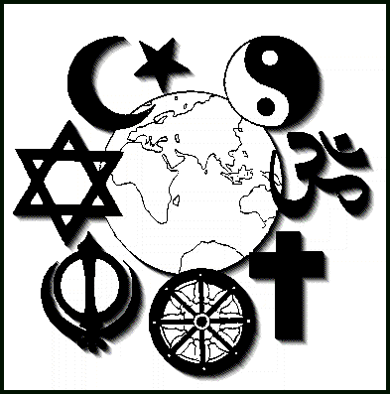
Religious Understandings
Jewish nation
Religious nations often develop their own distinct culture and language

Slide 12
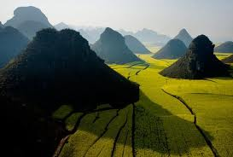
Geographic Understandings
Mountains, oceans, and deserts are physical barriers that often forced peoples to develop in isolation from other peoples
Tibet was isolated for thousands of years and developed their own language and culture, and forms of government

Slide 13
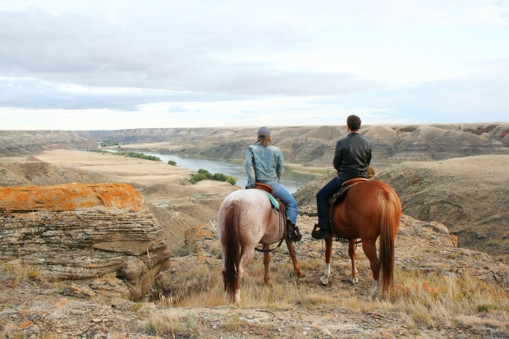
Relationship to Land as Understandings
Different geographic areas provide different resources and influence the way of life
Siksika people of South Alberta/Saskatchewan

Slide 14
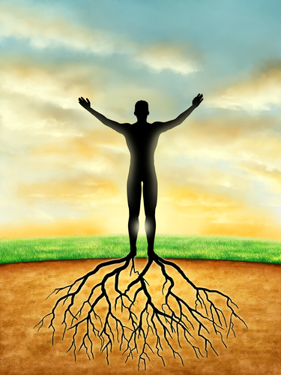
Spiritual Understandings
Share the same spiritual bond with land
These sites help bind people to the land and are an important aspect of spiritual identity
Jews, Christians, and Muslims are connected to the city of Jerusalem, as it is a holy city

Slide 15
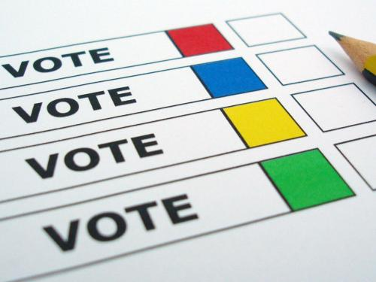
Political Understandings
Nation controlling their own political affairs
Desire for self-determination – power to control one’s own affairs
Sovereignty – the political authority to control one’s affairs

Slide 16
How can nation be understood as a civic nation?
Shared values and beliefs expressed in law
Making of a Civic Nation
Nation and Nation-state

Slide 17
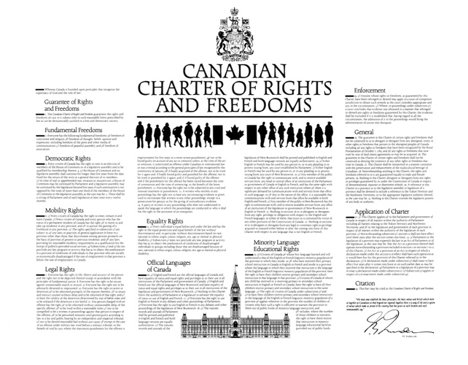
Shared Values and Beliefs in Law
The fundamental freedoms set out in Section 2 of the Charter express the foundational values and beliefs of Canadians
When people, no matter what their ethnicity, culture, and language, agree to live according to particular values and beliefs expressed as laws, they have created a civic nation

Slide 18
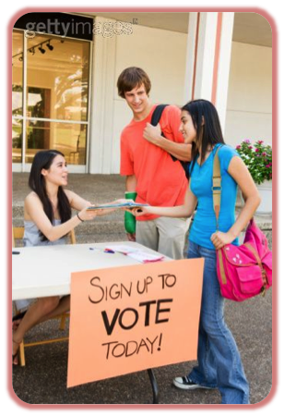
Making of a Civic Nation
“Civic” is an adjective that refers to citizens, who are a key element of a civic nation.
“Civic gov’t” refers to gov’t by citizens, and “civic involvement” refers to gov’t by citizens
Civic nation emerges from the choice of citizens to live together according to shared principles

Slide 19
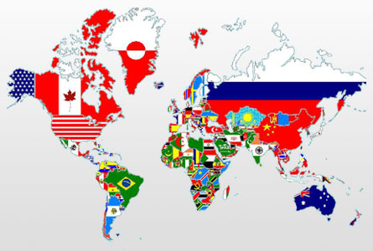
Nation and Nation-State

