Slide 1
How do some forces of globalization present challenges to identity?
The Metis Story

Slide 2
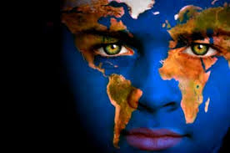
Intro
Globalization will help individuals expand their individual and collective identities, and promote understanding and co-operation
Globalization will is reducing diversity – and leading to cultural homogenization

Slide 3
The ‘AAA’ concept
Acculturation
Refers to the cultural changes that occur when two cultures accommodate, or adapt to, each other’s worldview
Accommodation
Involves accepting and creating space for one another and may affect customs, traditions, technologies, etc.
Assimilation
Occurs when the culture of a minority group is absorbed by another culture and the minority group disappears gradually

Slide 4
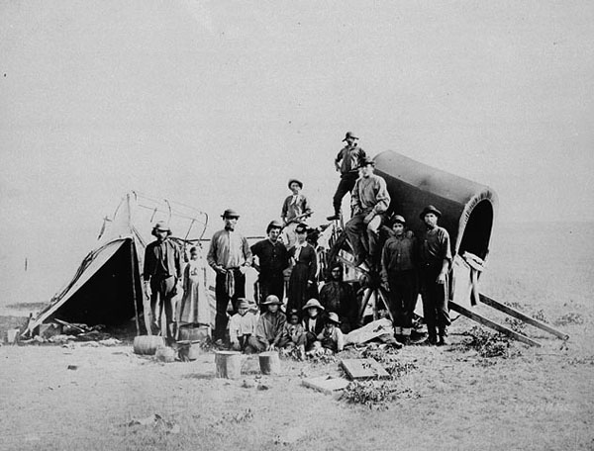
The Metis Story

Slide 5
Metis Origins
17th-19th century European fur traders married First Nations women
Their children were of mixed ancestry, creating the foundation of the Metis
“Metis” is the French word for ‘mixed’
As per the Metis Nation Ancestry;
“Metis means a person who self-identifies as Metis, is of historic Metis Nation Ancestry, is distinct from other Aboriginal Peoples and is accepted by the Metis nation”

Slide 6
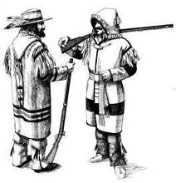
The Michif Language
“Michif” is a mixed language made up of Cree and French words and grammatical structures
It is spoken by some Metis people in northern Alberta, Saskatchewan, Manitoba, and the Northwest Territories
This language is an example of acculturation and accommodation

Slide 7
The Assimilation of ‘Inuktitut’ Language
Language of the Inuit
Was not an oral language until mid-1800s
Mostly symbols since origin, the Inuit are now making more words to represent certain legal, political and scientific concepts

Slide 8
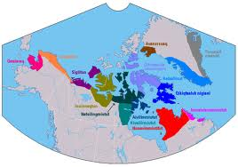
The Inuktitut Story

Slide 9
The Assimilation of ‘Inuktitut’ Language
Inuktitut is the official languages of Nunavut, it is in danger of disappearing
The ‘overwhelming power of English” has resulted in few children in western Nunavut speaking and understanding, Inuktitut
Go to website “Our Language, Our Selves”
http://www.nunavut.com/nunavut99/english/our.html

