Slide 1
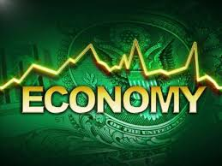
The Economy
Economic Systems, Economics and the role it has in our country

Slide 2
What is the economy?
Economy: The resources and processes involved in the production, distribution, and consumption of goods and services.
What do think the Canadian economy is like right now?
Is it the same throughout all of Canada? (Northern, Western, Central, Eastern)
What is the driving part of the economy in each region?

Slide 3
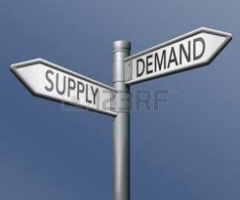
What is Economics?
Economics: THE STUDY OF the production, distribution and consumption of goods and services.
Economics focuses on the behavior interactions and explains how economies work.

Slide 4
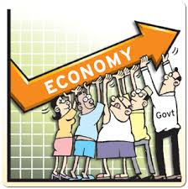
Economic systems
Economic System: The way a society organizes the production, distribution and consumption of goods and services.

Slide 5
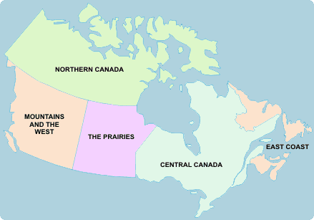
Regional Economics in Canada
Each area in Canada has a different thriving force for their own economy. Can you name each province & territory?

Slide 6
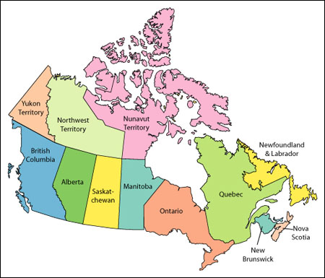

Slide 7
Regional investigation
In pairs and using an iPad or Mac, investigate what industries (forestry, fishing, manufacturing, etc.), drive the regional economies in Canada
You will be designated a specific region by your teacher
On the map of Canada provided, fill in the industries that drive your designated economy and wait for the rest of the class to finish to complete your map

Slide 8
Exit conversation
What is the economy?
What is economics?
What is an economic system?
Complete all three of these questions in YOUR OWN words on the exits slips provided.

