Slide 1
Historical Tweets
What would they have hashtagged?

Slide 2
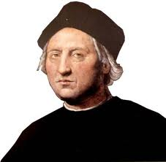
Rationale
People throughout history did not have access to social media like we do today.
But what if they did? What would they put on their Facebook profile? What would they Instagram? What would they Tweet?
Today’s activity will give you a chance to use social media and use it to make connections to historical perspectives.

Slide 3
Instructions
Get into groups of 3 (total of 6 groups), and move to a ‘workstation’ in the classroom
Receive your information from Mr. Lowe with the contents of your historical perspective
Grab an iPad
Go to www.twitter.com
One group member use your school email address to create a Twitter account for you historical person
justinlowe@edu.gpcsd.ca

Slide 4
Cont’d
Make sure you follow @MrLoweSJCHS, and eventually the other groups once they are set up
As a group, crate 10 Tweets that your person would have made during their life
Your Tweets MUST reflect the PERSPECTIVE towards HISTORICAL GLOBALIZATION
Be APPROPRIATE and CONSIDERATE
Follow the classroom Tweets on the SmartBoard

Slide 5
Lastly
Each group member will pick their favourite Tweet
You have 2 options
Option 1 – Orally explain to the class how your favourite Tweet reflects the perspective toward historical globalization
Option 2 – Go to Mr. Lowe’s website and write a blog entry that explains how the Tweet reflects the perspective towards historical globalization
Delete your Twitter accounts.

