Slide 1
Exploring Globalization
Social Studies 10-1
Mr. Lowe

Slide 2
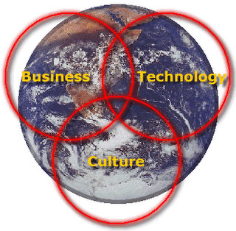
What do you see?

Slide 3
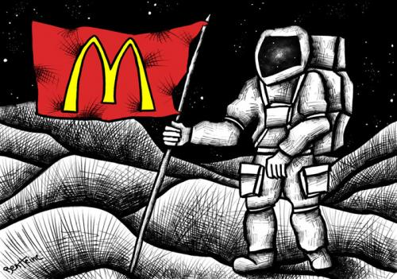
What do you see?

Slide 4
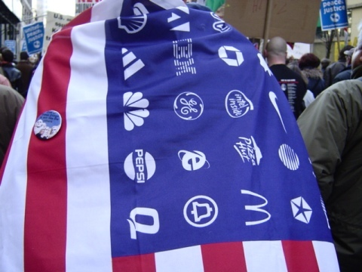
What do you see?

Slide 5
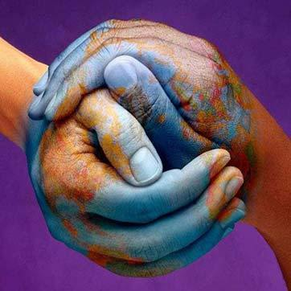
What do you see?

Slide 6
What do you see?

Slide 7
To what extent should we embrace globalization?
extent
embrace
globalization

Slide 8
Unfamiliar Words
Extent
Embrace

Slide 9
Globalization

