Slide 1
Continuing Affects of Historical Globalization
How are the legacies of historical globalization continuing to affect people?

Slide 2
The Dark Side…
What would have happened had colonization not taken place?
Colonization denied Indigenous and non-Indigenous peoples the ability to control their own destinies
Personal and collective identities, economic and political systems, were destroyed
Many people suffered poverty and oppression
The wealth produced by colonies benefited rich people and rulers in their home countries
These inequalities, laid the foundation for the in equalities that continue to exist in today’s global economy

Slide 3
Cultural Change
Cultures of people under European rule always grew
European religious beliefs were pushed, and Christianity changed the lives of people who ‘adopted’ it
Indigenous art turned Eurocentric
European architecture prevailed in villages/cities

Slide 4
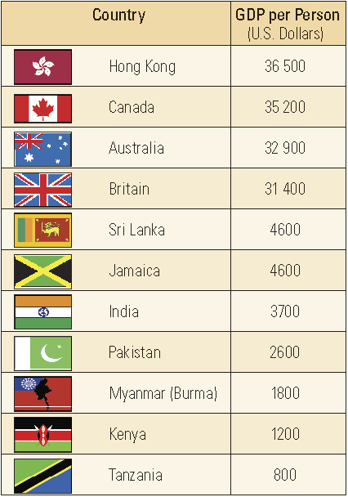
The GDP
Gross Domestic Product
“…a measure of the strength of a country’s economy”
Refers to the value of all the goods and services produced annually within a country’s borders

Slide 5
What do you see?
What conclusions does this chart help you draw about today’s legacies of historical globalization?
What other factors might you need to consider when drawing conclusions about these legacies?

Slide 6
Mapping Your Data Sets…
Country | Year of Independence
Hong Kong | 1997
Canada | 1867
Australia | 1961
Sri Lanka | 1948
Jamaica | 1962
India | 1947
Pakistan | 1947
Myanmar | 1948
Kenya | 1963
Tanzania | 1964

Slide 7
Legacies of Imperialism in India
Europeans had little effect on Indian culture, but lasting legacies on economic, political, and social structures
British controlled civil administration, and economics of export and import
In 1950, India’s constitution made India a parliamentary democracy based on the British model
Country has major problems with rapid population growth, poverty, sexual discrimination, high illiteracy rates and continuing conflicts with neighbouring countries

Slide 8
Legacies…
India and Pakistan
Kashmir
Muslim League wanted to divide India into two countries: one for Hindus and one for Muslims
India and Pakistan created
Many Muslims would end up in India, and Hindus in Pakistan
This created tension, violence, and discomfort
Joined India during independence, but Pakistan believed it was theirs
Two countries went to war over Kashmir from 1947-49 and again in 1965
Both have developed nuclear weapons since
The two countries have been trying to peacefully work out a resolution

Slide 9
Tasks…
Task 1 – complete “Legacies of British Imperialism in India”
Task 2 – read and complete # 1 & 2 – Pg. 154-155 “Aung San Suu Kyi and Dictatorship in Myanmar (Burma)”

Slide 10
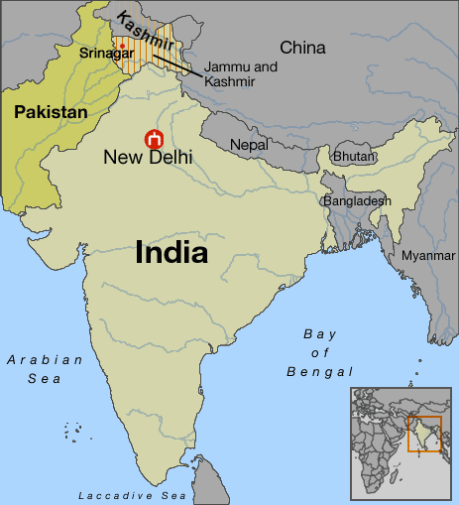
Pakistan, India, and Kashmir

