Slide 1
Consequences
How did the consequences of historical globalization affect people?

Slide 2
Workstation #1
South America – Spanish brought new plants and animals, mined silver and gold, enslaved many Indigenous Peoples, and sent all profits back to Spain
Spanish conquistadors pummeled spiritual relics, and transformed the religious and cultural customs of the Aztec Empire
North America – First Peoples benefitted from the fur trade, but were eventually forced from their traditional territories and were assimilated
“European diseases did more than European technology to vanquish the American Indian in the early years of colonization” – Karen Kuperman
75-90% of Indigenous Peoples (8-10 million), may have died as a result of contact with disease, particularly, Smallpox.

Slide 3
Workstation #2
Europeans and Indigenous Peoples knew nothing of each other
Each depended on the relationships they formed and the fur trade evolved, while Europeans did not know how to live in the wilderness
Bartolome de Las Casas – troubled by the destruction of the Indigenous cultures, and disgusted by the terrible cruelty he witnessed
European interests undermined his efforts (too profitable)
Regretted the suggestion that Africans be imported in hopes that they would be treated fairly
One of the first Europeans to speak out in defence of Indigenous Peoples

Slide 4
Workstation #3
Slavery existed before this time, and was often used as an alternative to imprisonment or execution
The growing demand for labour to work on colonial plantations brought into effect Chattel Slavery (ownership), and slavery based on racial origins
Chattel slaves had no legal standing as human beings
Olaudah Equiano – enslaved at 11 yrs old and put into war as a gunpowder carrier during the Seven Years War
Learned to read and write and bought his freedom and joined the movement to abolish slavery
1789 – more than 100 books were published on the Abolitionist movement

Slide 5
Workstation #4
Slaves were rarely allowed to read and write or leave plantations
Harsh treatment of slaves was becoming publicized and many grew to oppose the practice
Difficult because those who wanted to maintain slavery were wealthy and powerful slave owners
William Wilberforce – persuaded Parliament to ban trade in slaves, and became an increasingly unpopular ‘fanatic’
The Emancipation Act of 1833 – Britain and the British Empire abolished slavery

Slide 6
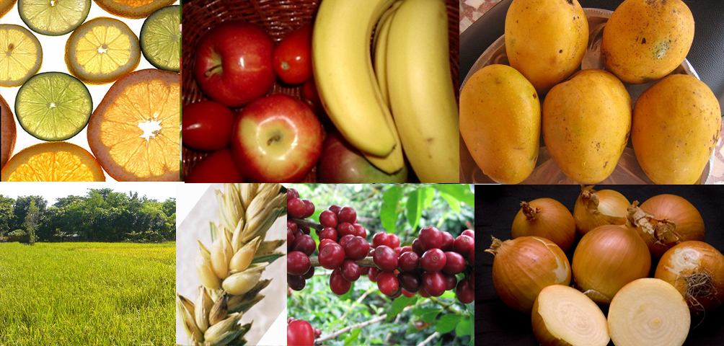
The Grand Exchange
“When Columbus returned to the Americas in 1493, he had no way of knowing that this voyage would change the world. Aboard his ships were seeds, fruits trees, and livestock. This cargo would start a revolution that would change the diet of the world forever – and form the basis of a trading process that is sometimes called: the Grand Exchange.”

Slide 7
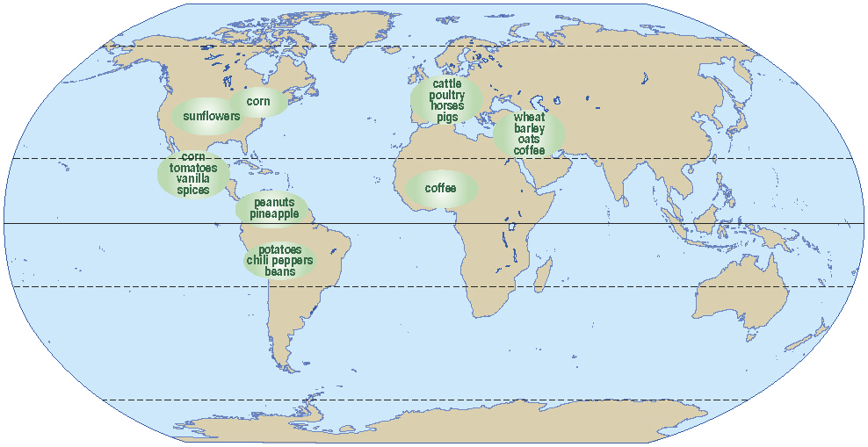
Changing the World Diet
Peanuts, Vanilla, Sweet and Hot Peppers, Lima Beans, Pineapple, Tobacco, Tomatoes, and Potatoes arrived in Europe and Asia
Coffee – cultivated in Africa, and Arabia, then imported to Americas
Wheat, Barley, Oats, Cattle, Poultry, Pork all imported to the Americas

Slide 9
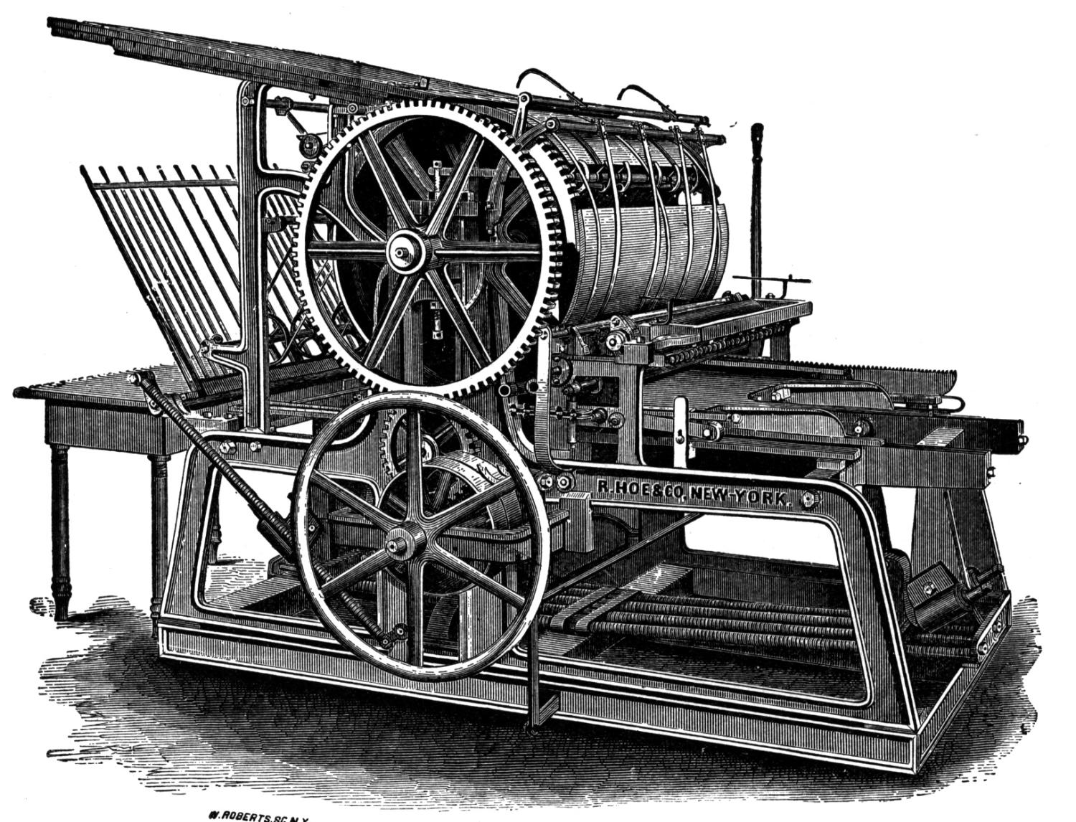
Industrialization & Social Change

Slide 10
Industrial Revolution
1750 – the steam-powered engine is invented in Britain and entrepreneurs used it to create new ways to mechanize the manufacturing process
1764 – the Spinning Jenny was invented in Britain allowing spinners of thread to keep up with demands of weavers
new machines were large, expensive, and often required many workers to operate them – only rich could afford them and build factories – rendering traditional craftspeople out of work

Slide 11
Industrial Revolution
1750-1850 is the era where the world became mechanized
This event sparked dramatic economic, social, and cultural changes
By 1830, Britain controlled/produced 2/3 of the world’s coal, ½ of its iron, and ½ of its cotton cloth

Slide 12
Your Tasks…
Cheap Labour – The Lifeblood of Historical Globalization
Pg. 128-129
#1 & 2
Points of View
Pg. 133
#1 & 2

