Slide 1
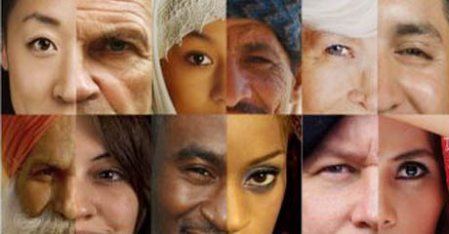
Collective Identities
The Groups we ‘Ride’ With

Slide 2
Lesson Questions
How do collectives express who they are?
How much of your identity is defined by your membership in collectives?

Slide 3
Collectives
“expressing your identity as a member of a group”
What do you think are some examples of collectives?
How have the collectives you have identified with changed as you have aged?

Slide 4
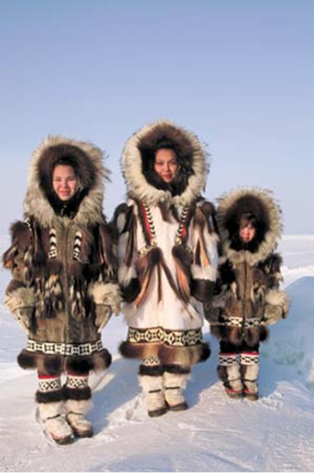
What is the Collective Identity?

Slide 5
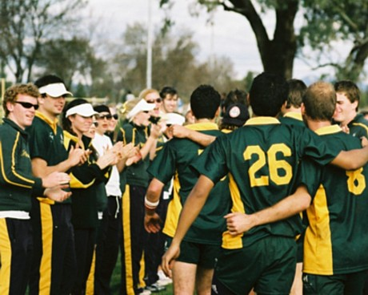
What is the Collective Identity?

Slide 6
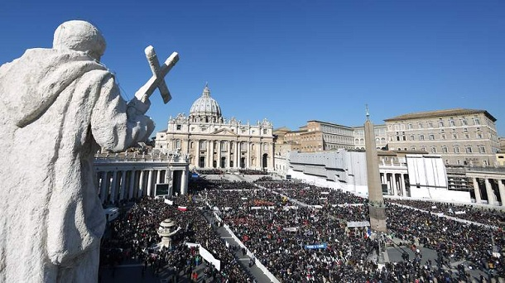
What is the Collective Identity?

Slide 7
What is the Collective Identity?

Slide 8
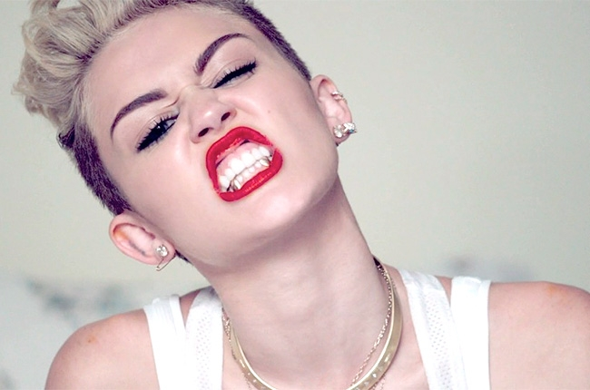
What is the Collective Identity?

Slide 9
Expressing Collective Identities
Divide into 6 groups (as even as possible, I hold the right to ‘shuffle’ the groups)
Using textbooks, phones, iPads, or iPods; examine the specific topic you are given (you will get your topic when groups are settled)
Using the tools given, create a visual that you will briefly present to the class upon completion

Slide 10
Topics
Links between Collective Identity and Language
Links between Collective Identity and Slang/Jargon
Links between Collective Identity and Context

Slide 11
Struggling Identities
Teen Identity
Lubicon Cree
Handout
Discuss the article
Does anyone identify with this article?
Pg. 32 of textbook
Read Case Study and respond to questions of Exploration on pg. 33
#1-3
Submit to Mr. Lowe

