Slide 1
Reconciling Nationalist and Non-Nationalist Loyalties
Chapter 4

Slide 2
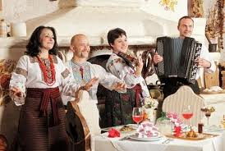
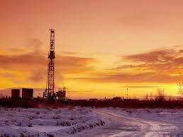
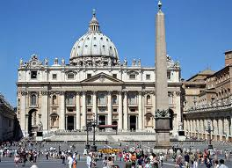
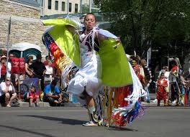
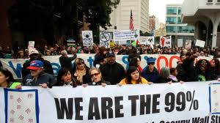
Ethnic Loyalty
What are Non-
Nationalist loyalties?
Regional loyalty
Alberta Oil Sands
Religious loyalty
The Vatican
Cultural loyalty
Class Loyalty
Occupy Movement

Slide 3
How do Nationalist and Non-Nationalist loyalties contend (compete)?

Slide 4
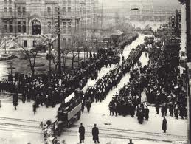
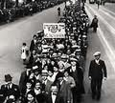
When class and nationalist loyalties compete
Classes are a way of dividing society according to wealth or status or education …
The Winnipeg General Strike:
Just after WW1
Most people were poor and wanted to be protected by unions and many people went out on strike (stopped working)
Employers didn’t want unions, so they called the RCMP: 2 were killed, 30 were injured and the strike was broken.

Slide 5
Watch The Winnipeg General Strike (part 1 and 2)
10 key ideas about the Winnipeg General Strike…5w’s
Winnipeg General Strike
Who
When
Why
How

Slide 6
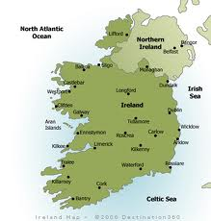
When Religious and Nationalist Loyalties Compete
Religious Loyalties in Northern Ireland
In the 16th Century, Great Britain, which was Protestant, ruled Ireland, which was Catholic
There was lots of conflict; for example, Catholics were forced to move away from their home to a less favorable part of the country.
There was murderous violence from the 1960’s until 1999, a period called the Troubles.
They eventually negotiated a peace.
http://www.youtube.com/watch?v=_SQs__ttqL8

Slide 7
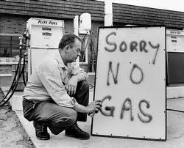
When Regional and National Loyalties Compete
Oil, gas and Regional Loyalty
Inflation –prices rise quickly and the dollar buys less
In 1970, Arab countries stopped selling oil to Western countries, which made the price go up.
Lots of people throughout Canada lost their jobs, but things were going well in Alberta because of the high price of oil.
Prime Minister Trudeau decided that Alberta would sell its oil at a lower price, and taxed it heavily.

Slide 8
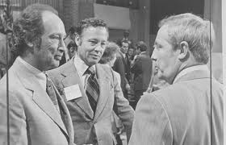
The National Energy Program (NEP)
Trudeau’s plan of forcing Alberta to sell its oil at a lower price was called the NEP.
The NEP caused oil companies to do business in other places, which caused unemployment and tough times in Alberta.
1981 – Premier Lougheed & Trudeau eventually agreed to allow Alberta to control oil prices & revenue

Slide 9
Oil Sands
Ideological Loyalties
People who support oil sands development may be inspired by regional loyalties. They may believe that the oil sands benefits Alberta and the rest of Canada.
The same people may think that the price is too high because of damage to the environment. For example, 3000 km of forest was destroyed. Their ideological loyalty to environmentalism may compete with their regional loyalty.
When the price of oil continued to rise steadily, it became possible to invest in the oil sands in Alberta, which helped build opportunities and prosperity in the province

Slide 10
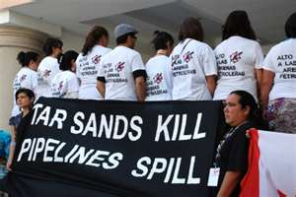
The oil sands and cultural loyalties
Development has tested First Nations’ people’s loyalty to their traditional ways of life and culture.
The oil sands have provided jobs, but have also caused pollution, used up a lot of water and have made it difficult to hunt and trap.

Slide 11
Watch CBC Doc Zone – Tar Sands The selling of AB
Positive effects of Oil Sand Development | Negative effects of Oil Sand Development

Slide 12
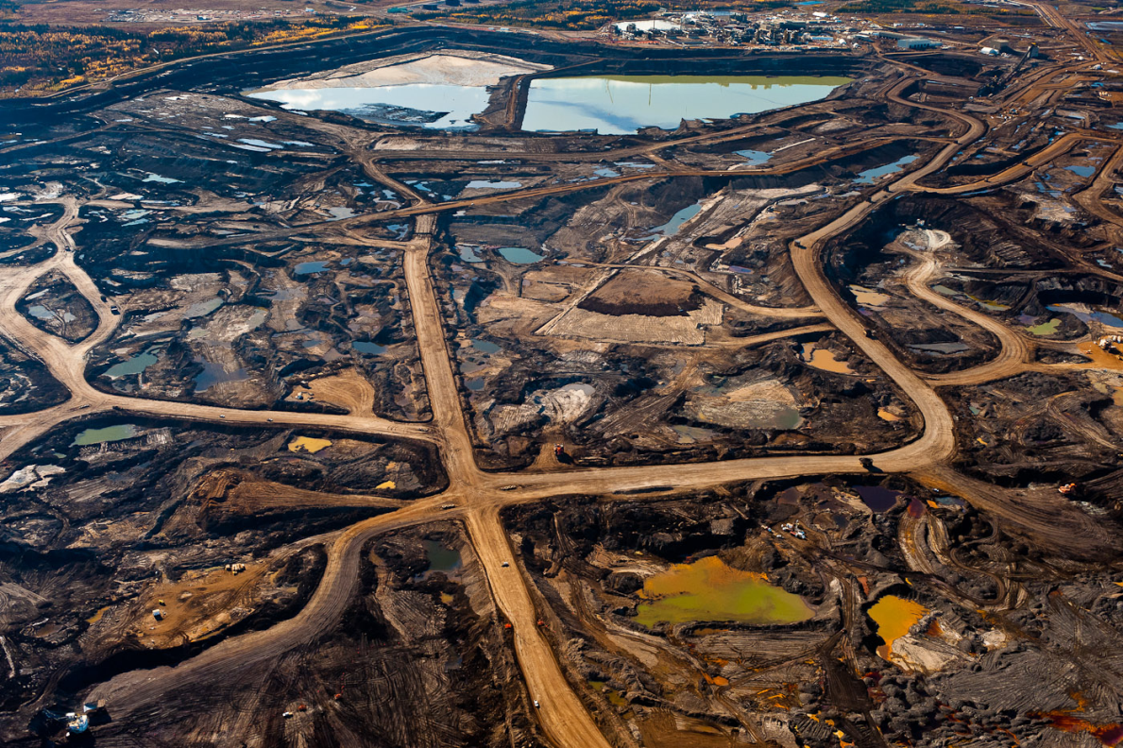
Do You Support Oil Sand Development in Alberta?

Slide 13
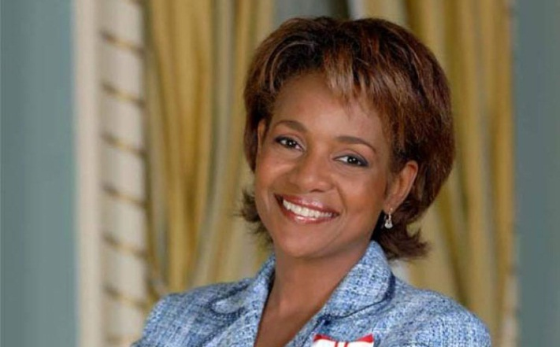
Living With Contending Loyalties
How does an individual choose 1 loyalty over another?
To deal with contending nationalist loyalties, people often have to sacrifice an important part of their identity.
This often leads to feelings of alienation – feelings of being on the outside or left out.
Michael Jean used her coat of arms to include both nationalist and non-nationalist symbols (see page 97)

Slide 14
Bringing about Change in the Nation (page 98)
Some people try to change their nation to accommodate non-nationalist loyalties.
Eg. Fighting for First Nations women
Black History month, Michael Jean praised black people in Canada for fighting for rights.

Slide 15
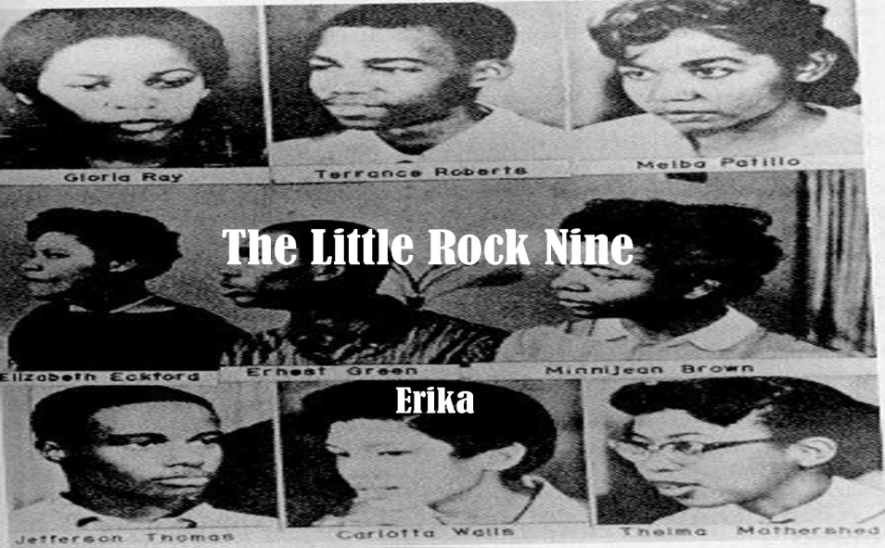
Segregation (page 99)
Fighting for a Sense of Belonging – South African policy but was present in the American South
1957, segregation- forced separation of racial groups occurred in Central High School in Little Rock, Arkansas.
9 black teenagers became the first blacks to attend the school.
Angry whites gathered outside the school, insulting them as they tried to enter the school. This went on for days.

Slide 16
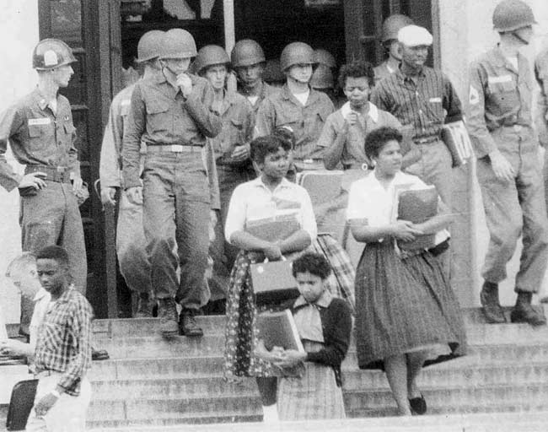
Little Rock Nine
US president sent in the army to protect the teens.
Brown Trickery endured this for 5 months (believed in non-violence), finally she started to fight back, was expelled.

Slide 17
Fighting for Religious Freedom
The Charter of Rights and Freedoms now guarantees freedom of religion in Canada.
Still, gov’t action can affect religious groups in Canada.
E.g. 2003 Alberta, like other provinces passed a law requiring a photograph on all driver’s licences. But, Hutterites in Wilson Siding Colony in southern Alberta fought this ruling as from their perspective, the bible prohibits them from willingly having their picture taken.
**obeying the law would mean violating their religious beliefs. But following their religious beliefs would mean they could not have a driver’s licence.
Charter of Rights and Freedoms favored the Hutterites but has since been handed over to the Supreme Court of Canada.

Slide 18
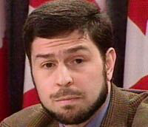
Making Reconciliation Work
Task 1: Watch the video on Maher Arar….Summarize the events that effected Maher Arar (point form), and the outcome.
Why was Arar targeted?
Why did the Canadian and American Gov’t act as they did?

