Slide 1
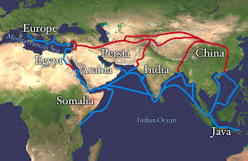
How & Why?
The Beginnings of Globalization

Slide 2
Intro
Some believe when Chandragupta Maurya combined religion, trade, and military might to create a protected trading area in present-day India (325 BCE)
Some believe when Genghis Khan, Mongolian warrior-ruler, introduced the idea of fighting from horseback and conquered much of Asia (1100s)
Some believe when Christopher Columbus landed on the Americas (1492)

Slide 3
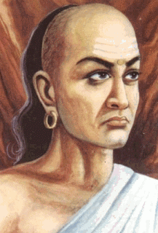
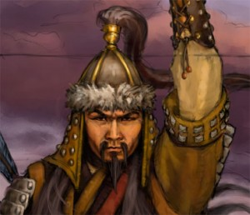
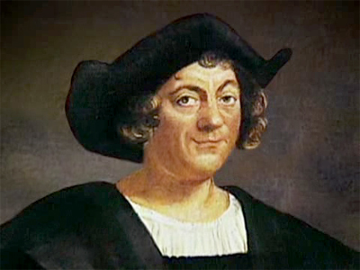
What do you think?

Slide 4
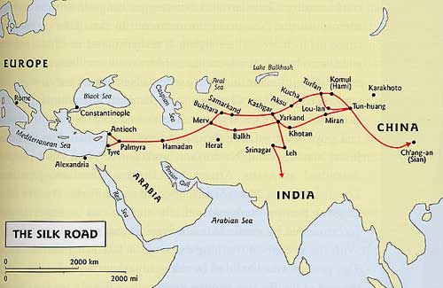
The Silk Route
Approx. 300 BCE evolved a fragile network of caravan tracks linking Asia and Europe
Known as the ‘Silk Road’ for the silk made in China
First transportation of prized goods, such as silk and peppercorns

Slide 5
The Silk Route
Ideas moved as well
The Indo-Arabic number system is an example
India
Middle East
Italy
Roman Empire
Europe
Americs
World

Slide 6
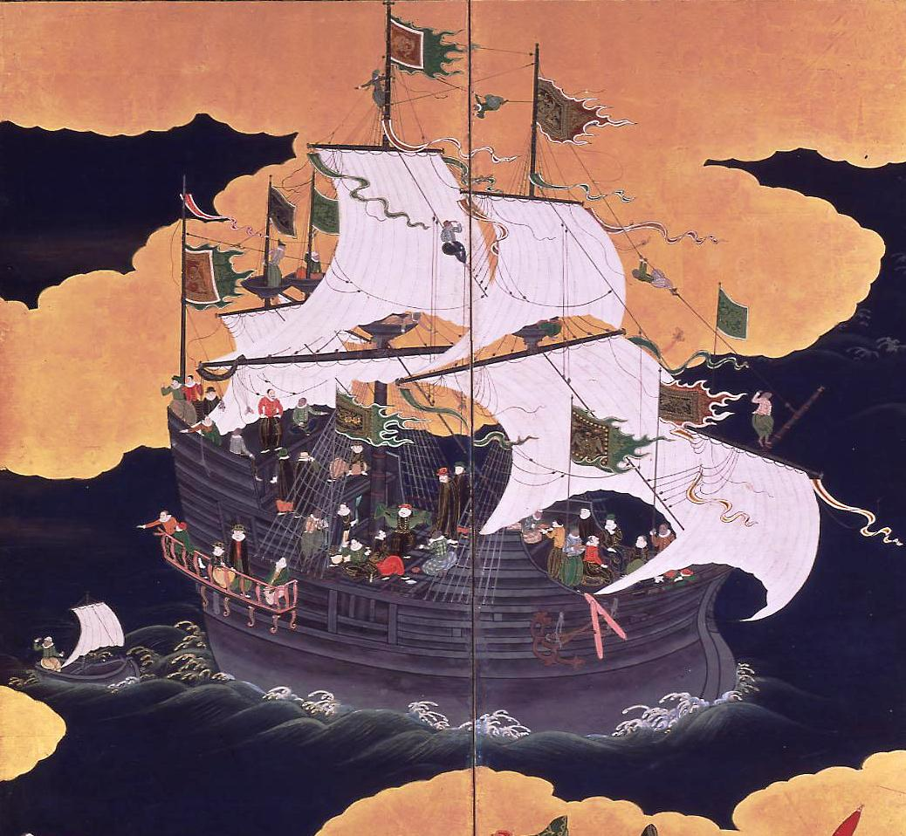
Theory of the Evolution of Globalization

Slide 7
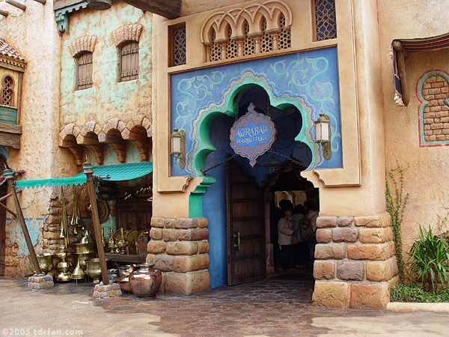
Phase 1
Goods and ideas exchanged on ancient trade routes
Arab nations acted as ‘brokers’ of science, literature, medicine, and mathematics
http://www.youtube.com/watch?v=VuWa2XX7p2g

Slide 8
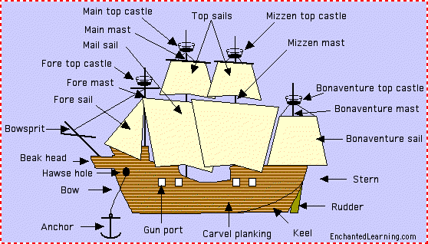
Phase 2
Began in the late 1400s
Europeans developed technologies enabling them to sail much farther than ever before
Hence, globalization was related to Imperialism

Slide 9
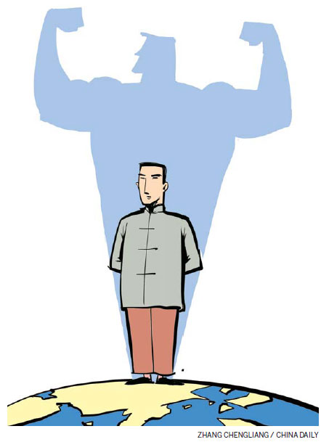
Phase 3
We are now in this phase
Transitioned after WW2
Rapid growth in world markets and instant communications
Predict the rise of economic powers China, and India

Slide 10
Historical Globalization
Referred to as Phase 2, specifically with the voyage of Christopher Columbus in 1492, and ended with the emergence of the United States and the Soviet Union as superpowers after WW2
Others believe that this began in the 1800s, when low-cost goods from farms and factories poured into markets around the world – and access to these goods changed the way people lived

