Slide 1
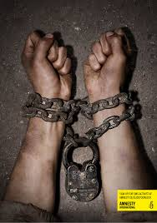
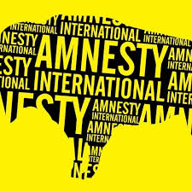
Amnesty International
By: Nikki, Hailey, Mitchell & Aidan

Slide 2
What is amnesty International?
Founded in 1961, Amnesty international is a non-governmental/ human rights organization supported by more than 3 million followers; all working to end the grave abuses of human rights around the world. They specifically work to abolish the death penalty ‘in all cases and under all circumstances’. Amnesty International’s goal is to provide everyone with equal opportunity to the Universal Declaration of Human Rights and other international human rights standards worldwide.

Slide 3
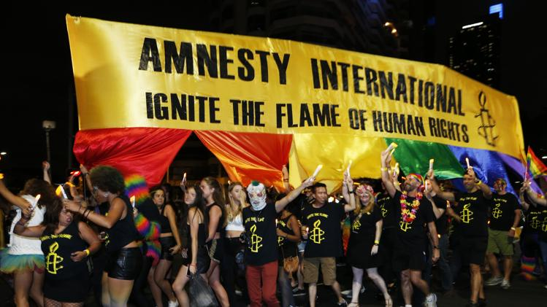
How does is work?
Amnesty International works to stop human rights abuses by raising public awareness through campaigning via: public demonstrations, letter writing campaigns, direct lobbying ect. They also send experts to talk to the victims who’s rights are being denied, so they can publicize their stories and inform the media and government through published reports. If successful, they are able to free the victims and reintegrate them into a society where they are free to practice their own rights.

Slide 4
How is the organization set up?
Amnesty International is a non-governmental organization, which means they are independent of any government, political ideology, economic interest or religion. They are strictly funded by their own membership and public donations. The majority of this organization is made up of voluntary members with few paid professionals. These members are broken off into to groups or ‘sections’ to specifically target different countries in need of their help.

Slide 5
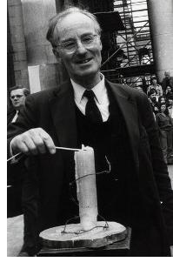
What is the history of the Organization?
Amnesty International was created by a British lawyer, by the name of Peter Benenson, after publishing an article in the newspaper about two Portuguese students who were imprisoned for making a toast to their freedom. His article, “The Forgotten Prisoners”, launched the “ Appeal for Amnesty 1961”; which was a vastly successful campaign that raised interest and awareness globally of human rights abuses. It was because of this that Amnesty International was officially founded as a human rights organization in 1961.
Peter Benenson lighting the Amnesty Candle

Slide 6
What is it’s Role in internationalism?
Their role is to bring communities together in the effort to support on main goal. Amnesty International does more them promote and protect human rights, they bring other communities closer. An example would be that over 65,000 Canadians sent letters, signed petitions or stood in front of our parliament back in 2011 to support the indigenous people of Colombia.

Slide 7
What does it promote?
Amnesty International promotes the right for everyone to be able to practice their rights and freedoms no matter their race, religion, or culture. They also promote the importance of Human Rights Education, which teaches kids what they have a right to and teaching them the value of protecting their rights as well. Equality is the foundation of their organization, promoting a new global way of thinking, reaching out to more than 150 countries and conducting 3,341 missions.

Slide 8
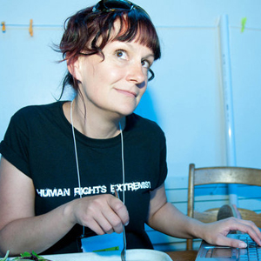
Who are the major members?
Amnesty International is all about normal people supporting and helping others. Because of this, there are no major members. There are however major groups within Amnesty international. There are groups depending on age, like the youth group, or geographic like the British Colombia and Yukon group. These groups exists to help on another in a combined goal in helping others.
This is Shauna, the leader of amnesty international for youth and students.

Slide 9
Why are countries involved in this organization?
The countries who are involved with Amnesty International are the countries whom are willing to work with the organization to end grave abuses of human rights. The people of the supporting countries support what Amnesty International is trying to achieve in this world. The collective vision is for every person to enjoy all the rights enshrined in the Universal Declaration of Human Rights and other international human rights standards. Amnesty International has more than 2.8 million members, supporters and subscribers in over 150 countries and territories, in every region of the world. There are also 80 Amnesty offices around the globe.

Slide 10
Why do countries refrain from involvement in the organization?
Countries such as: Israel, the Congo, China, Vietnam, Russia and the United states have refrained from Amnesty International involvement and have attacked them claiming AI to be a ‘one-sided reporting or a failure to treat threats to security as a mitigating factor’. These countries however have been the subject of human rights concerns voiced by Amnesty. The Catholic Church also criticizes Amnesty for its position on abortion.

Slide 11
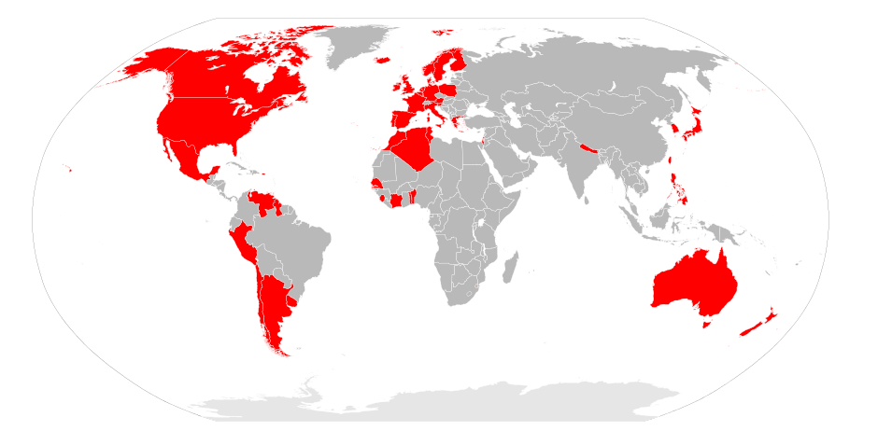
Over 50 years Amnesty International has been able to help over 150 countries globally against the struggle to end human rights abuses.

Slide 12
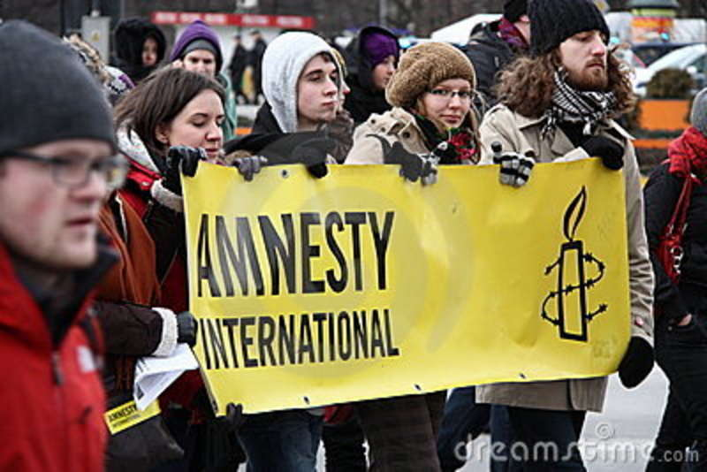
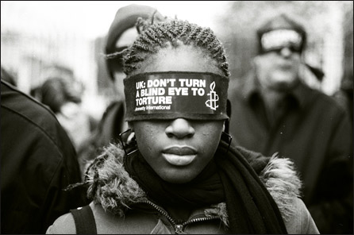
http://youtu.be/u1OrYp7C4Ew

